Slide 1

Apache Flume

Slide 2
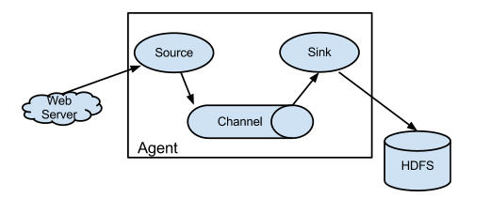
Gentle Introduction to Flume
Source will collect the data from WebServers, log servers etc.
Sink will write the data to HDFS.
Channel will pass the data from Source to Sink.

Slide 3
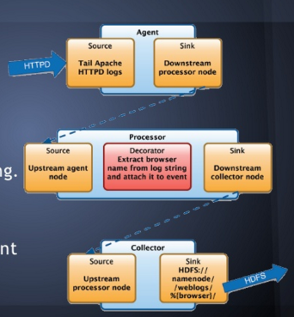
The Flume Model: Agent, Procesor and Collector nodes.
Agent receives the data from an application.
Processor will do some intermediate processing
Collector will write data to permanent storage.

Slide 4
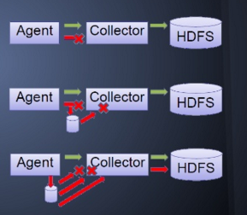
reliability
If data gets corrupted over channel, it is resent.
Store on failure and retry.
If agent fails, another agent will be initiated.

Slide 5
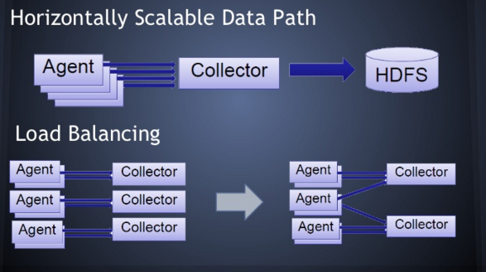
reliability
Multiple Agents and Multiple collectors will ensure Scalability in data ingestion.

Slide 6
More information
https://flume.apache.org/FlumeUserGuide.html

